Slide 1
SD CARD INTERFACE WITH FPGA ON MULTIMEDIA APPLICATIONS
MEMBERS :
SAKTHEKANNAN M S(212219060228)
UDAYA KRISHNAN M (212219060284)
YOGAVIGNES BM(212219060302)
GUIDE: Dr. Srigitha S Nath

Slide 2
OBJECTIVE
The main goal of SD (Secure Digitals) card is to provide a storage.
SD card is a low-cost, removable, non-volatile, flash memory, portable and easy-to-use storage solution for FPGA for storing large files. The hardware design is done in Verilog HDL language and implemented in FPGA.
All data access from the SD card is through Verilog HDL, eliminating the need for an on-chip microcontroller or general-purpose processor.
Large capacity SD card, high speed data transfer speeds, great flexibility, great mobile security.

Slide 3
ABSTRACT
Based on FPGA (Field Programming Gate Array) chips, this application is used for audio and image processing.
At the same time, applications require more memory in addition to on-chip memory to resolve additional data. Onboard memory can be used to meet the requirements of FPGA systems but cannot be expanded by adding just a few cards.
More convenient is SD card (Secure Digitals) which can read and write to SD card.
FPGA (Spartan 6) runs on 5V power supply with a built-in oscillator frequency of 100 MHz A 4GB micro SDHC card (class 6) from Strontium is used.
FAT32 is formatted by SD card. The ultimate aim of this project is to read a BMP image file from the SD card. FAT32 is formatted by SD card before interfacing.
The code for the FAT32 is written to interface the SD card.

Slide 4
INTRODUCTION
Secure Digital (SD) cards are proprietary non-volatile cards. New generation semiconductor-based memory card an electronic device designed primarily for data storage portable or fixed application.
Main advantages of SD cards are small, have large storage capacities and fast data bits, price, high energy efficiency, great flexibility, excellent safety.
SD card along with a USB memory stick portable storage device most commonly used in digital systems about microprocessors, microcontrollers and Digital Signals Processor (DSP) or Field Programmable Gate Array in various applications such as (FPGA) chips, digital cameras, laptops, mobile phones, embedded systems.
A Field Programmable Gate Array (FPGA) is electronic device. A device built as an array of configurable logic elements (LE).
Supports 3 SD cards communication protocol: 1-bit SD mode, 4-bit SD mode and Serial Peripheral Interface (SPI) mode.
FPGAs are a powerful tool that can be used as a type of microcontroller. Although, they have limited capacity FPGAs have a wide variety of components that allows them to perform as well as a PC or even as a server.

Slide 5
LITERATURE REVIEW
YEAR | AUTHOR | TITLE | PROS
2022 | Dumitrel Cătălin Costache, Lucian Andrei Perișoară,Adriana Florescu | FPGA Implementation of a SD Card Controller using SPI communication | Adding number of SD cards involves sharing the same clock and data signals and different chip-select signals for each card.
2011 | Omar Elkeelany | Data Archival to SD Card Via Hardware Description Language | Real-time design of data archival to the SD card that is used in data concentrator applications for remote sites.
2019 | Gul Munir Ujjan, Abdul Malik, Shakil Ahmed, Mohd Zaid Abdullah | Implementation of 4-Bit Data Transmission for Accessing SD Card with FPGA Embedded Soft Processor | Read operation with SD 4-bit mode is 67% faster than SD 1-bit mode and write operation in SD 4-bit mode is 80% faster than SD 1-bit mode.
2020 | Víctor Asanza, Alisson Constantine, Stephany Valarezo, and Enrique Peláez | Implementation of a Classification System of EEG Signals Based on FPGA | the implementation of FPGA-based classification systems, it is proposed to change the SD memory for a Double Data Rate 3 Synchronous Dynamic Random-Access memory, and test with different configuration to reduce the access time.
2010 | Zhenlin LU, Jingjiao LI, Yao Zhang | The reading/ writing SD card system based on FPGA | FPGA system can read and write data on SD card, good to meet the FPGA system needs for external storage devices. It involves SD card reader that can be applied to variety of FPGA based system.

Slide 6
EXISTING METHOD

Slide 7
PROPOSED METHOD

Slide 8
REQUIREMENTS
Xilinx Spartan 6 Software.
FPGA (Field Programming Gate Array).
SD card.
FAT32.
SPI (Serial Peripheral Interface).

Slide 9
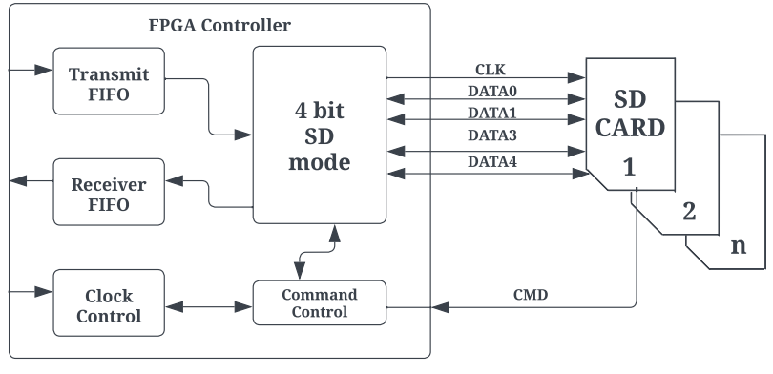
FPGA BLOCK DIAGRAM

Slide 10
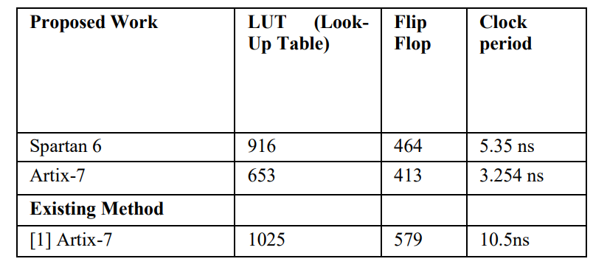
RESULT
Comparing the specifications of the Spartan 6 FPGA (530 Slice Registers, 916 LUT's, 464 Flip Flops, 5.35 ns clock period, 186.925 MHz frequency) and the Artix-7 (512 Slice Registers, 653, LUT's, 413 Flip Flops, 3.254 ns clock period, 307.342 MHz frequency) demonstrates that our proposed results provide better resource utilization than existing methods.

Slide 11
CONCLUSION
This research proposes an FPGA controller for SD card reading/writing in 4-bit SD mode.
It is allowed to address individual cards out of sequence, notwithstanding the architecture's suggestion.
There is a large quantity of storage capacity available.
Easily expandable storage system add number SD cards contain sharing the same clock and data signals different chip select signal for each card was suggested the architecture involves accessing each card in sequence, but it is allowed. Availability of large amounts of memory.

Slide 12
REFERENCE PAPERS
[1] D. C. Costache, L. A. Perişoară and A. Florescu, "FPGA Implementation of a SD Card Controller using SPI communication," 2020 12th International Conference on Electronics, Computers and Artificial Intelligence (ECAI), 2020, pp. 1-4.
[2] Zhenlin LU, Jingjiao LI, Yao Zhang. 2010. The Reading/Writing SD Card System Based on FPGA. 2010 First International Conference on Pervasive Computing Signal Processing and Applications (PCSPA), pp. 419-422.
[3] O. Elkeelany and V. S. Todakar, "Data Archival to SD Card Via Hardware Description Language," in IEEE Embedded Systems Letters, vol. 3, no. 4, pp. 105-108, Dec. 2011.
[4] Gul Munir Ujjan, Abdul Malik, Mohd Zaid Abdullah, Shakil Ahmed, “Implementation of 4-bit data transmission for accessing SD card with FPGA Embedded Soft Processor;” ICIIT '19, February 20–23, 2019, DaNang, Viet Nam.
[5] Jiayi Qiang, Yong Gu and Guochu Chen, “FPGA Implementation of SPI Bus Communication Based on State Machine Method,” Journal of Physics: Conference Series 1449 012027, 2020.
[6] Pallavi Polsani, V. Priyanka.B, Y. Padma Sai, “Design & Verification of Serial Peripheral Interface (SPI) Protocol,” IJRTE, Volume-8 Issue- 6, March 2020.
[7] Fareha Naqvi, “Design and Implementation of Serial Peripheral Interface Protocol Using Verilog HDL,” International Journal of Engineering Development and Research 2015.
[8] N Nandhagopal, S Navaneethan, V Nivedita, A Parimala, D Valluru “Human Eye Pupil Detection System for Different IRIS Database Images” Journal of Computational and Theoretical Nanoscience volume 18, issue no 4, page no 1239-1242, 2021.
[9] Manish Kumar Birla. 2006. FPGA Based Reconfigurable Platform for Complex Image Processing. IEEE, 6th International Conference on EIT, pp.204-209.
[10] V. Asanza, A. Constantine, S. Valarezo and E. Peláez, "Implementation of a Classification System of EEG Signals Based on FPGA," 2020 Seventh International Conference on eDemocracy & eGovernment (ICEDEG), 2020, pp. 87-92.
[11] S Navaneethan, N Nandhagopal, V Nivedita “An FPGA-based real- time human eye pupil detection system using E2V smart camera”, Journal of Computational and Theoretical Nanoscience 16 (2), 649-654 2019.
[12] Yansi Yang, Yingyun Yang, Lipi Niu, Huabing Wang and Bo Liu, "Hardware system design of SD card reader and image processor on FPGA," 2011 IEEE International Conference on Information and Automation, 2011, pp. 577-580.
[13] M. K. Birla, "FPGA Based Reconfigurable Platform for Complex Image Processing," 2006 IEEE International Conference on Electro/Information Technology, 2006, pp. 204-209

